Slide 1

SHEL KARIUKI
Let youR shine:
Making shiny apps mobile responsive
Notes:
Hi, my name is Shel and I’m here to share tips you can use / follow to make your shiny apps mobile responsive in the quickest way possible.

Slide 2
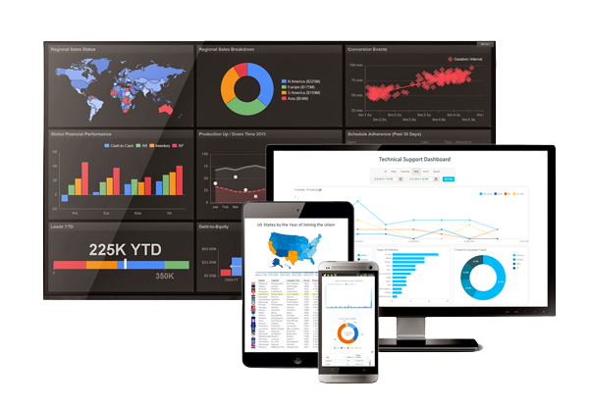

Slide 3
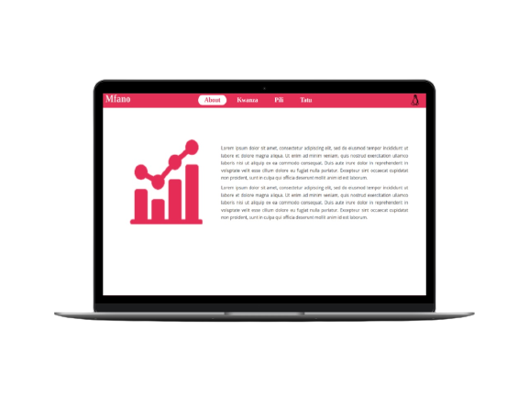

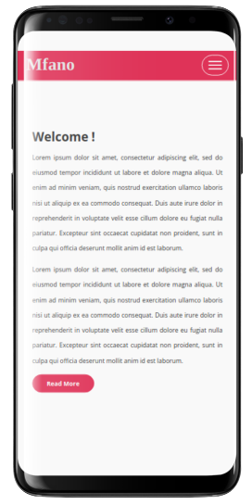
bit.ly/mfano
Case Example

Slide 4

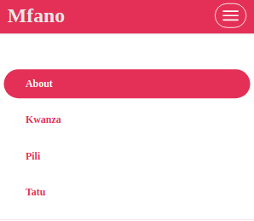
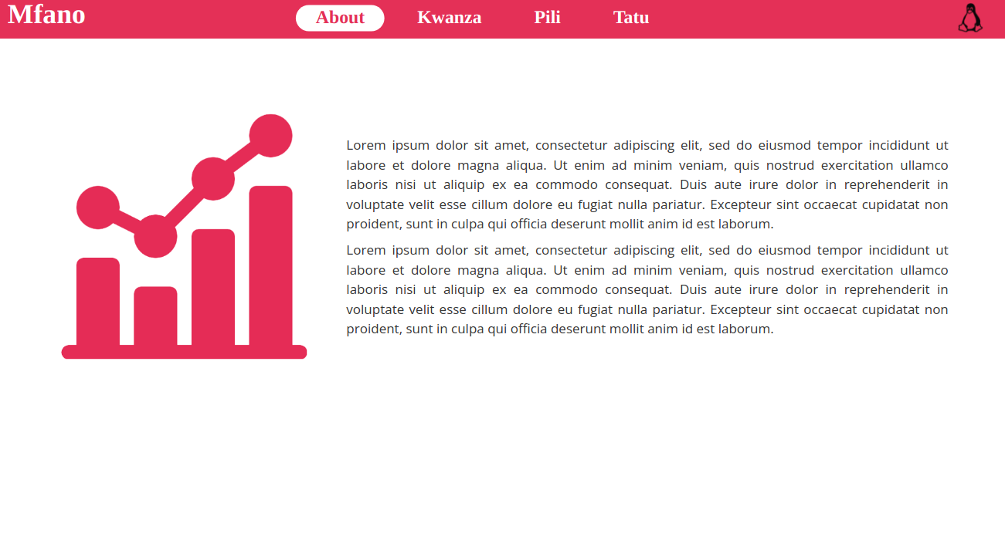
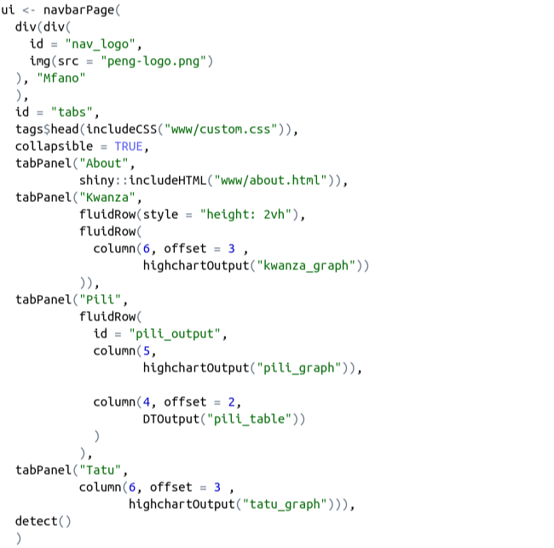
Collapsible Menu
.
bit.ly/mfano

Slide 5

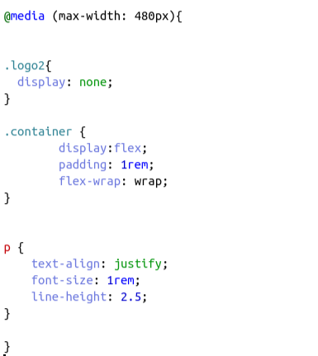
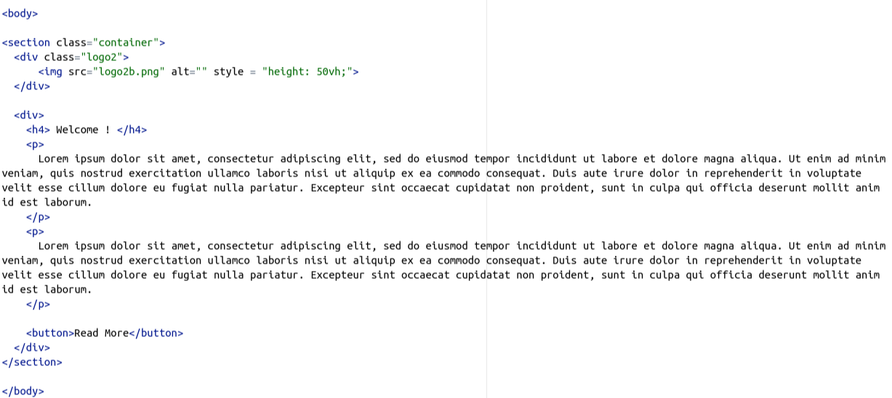
Remove some objects
.
bit.ly/mfano
Removed
Removed
Introduced

Slide 6


shinybrowser::detect()
.
{shinybrowser} lets you easily detect a user's web browser information in Shiny apps.
The width and height of the browser window are only reported once, when the detect() function is initially called.
If the user resizes the browser window, the new dimensions are not reported until the page is refreshed.

Slide 7
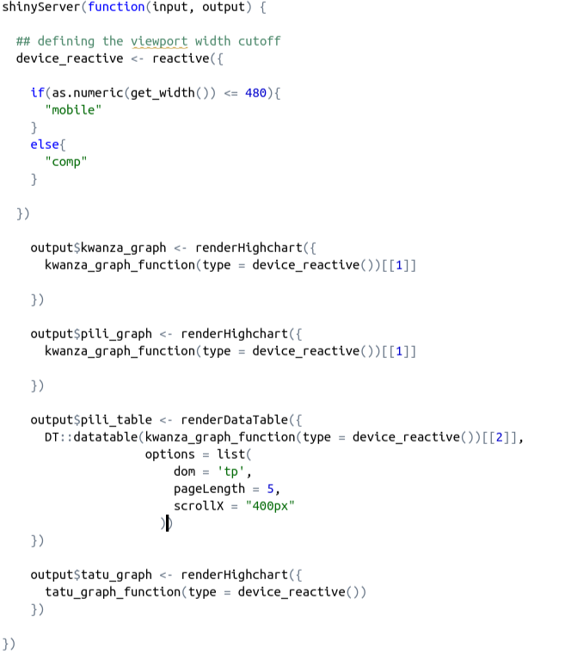

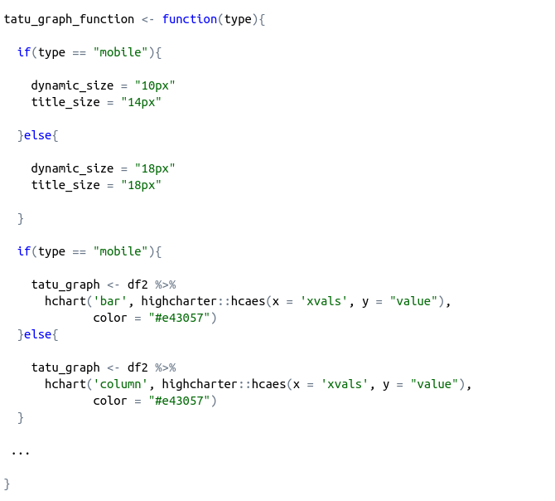
Reduce font-size

Slide 8
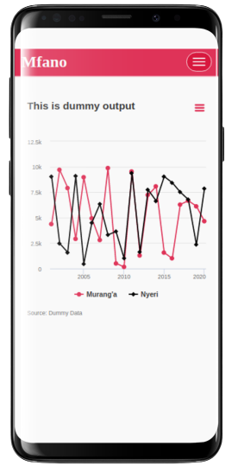
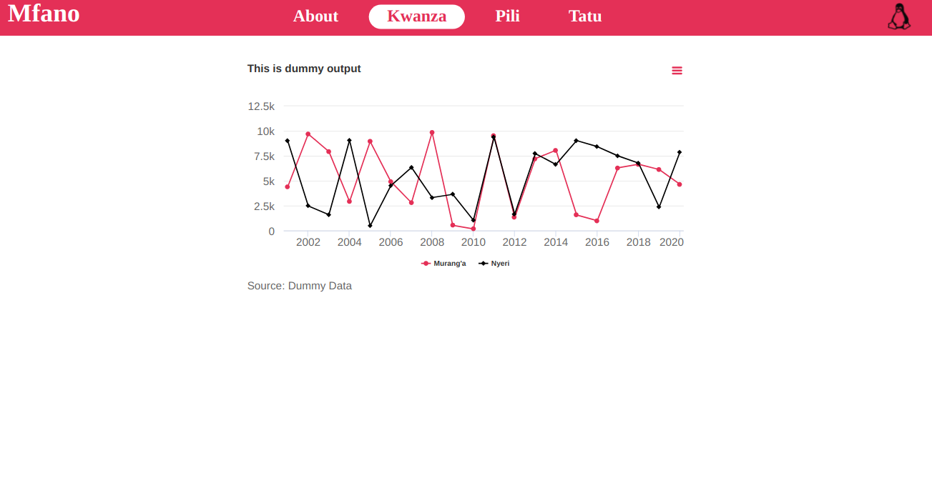
bit.ly/mfano

Slide 9
Change type of graph

Slide 10
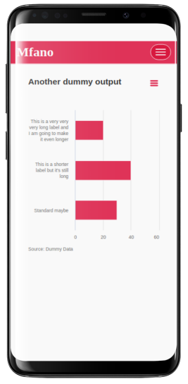
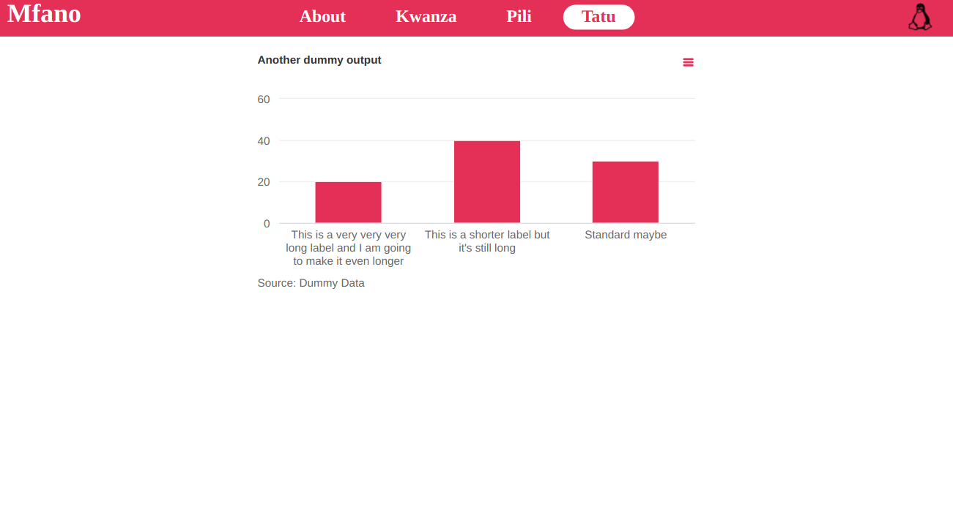
Change type of graph
bit.ly/mfano

Slide 11

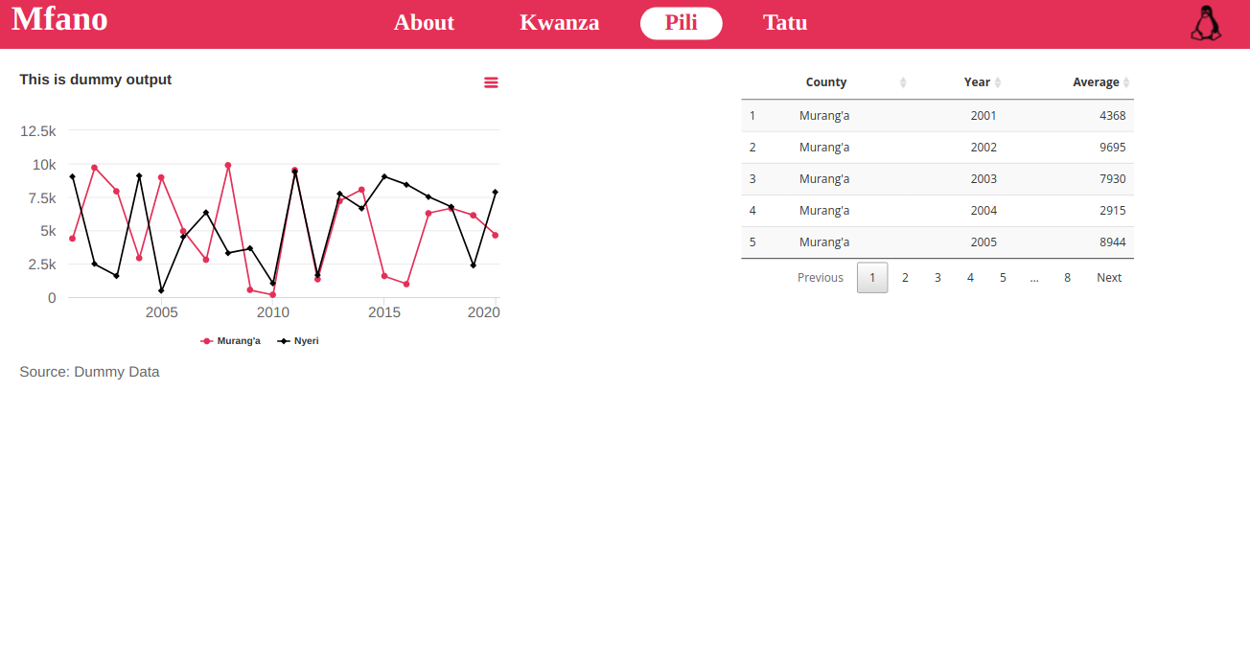
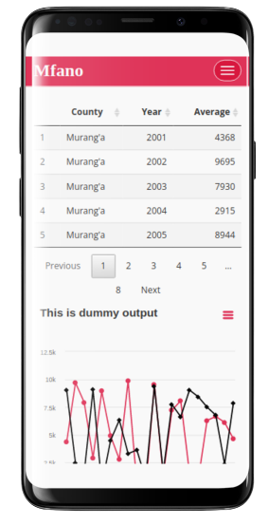
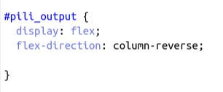
Change order of elements
.
bit.ly/mfano

Slide 12

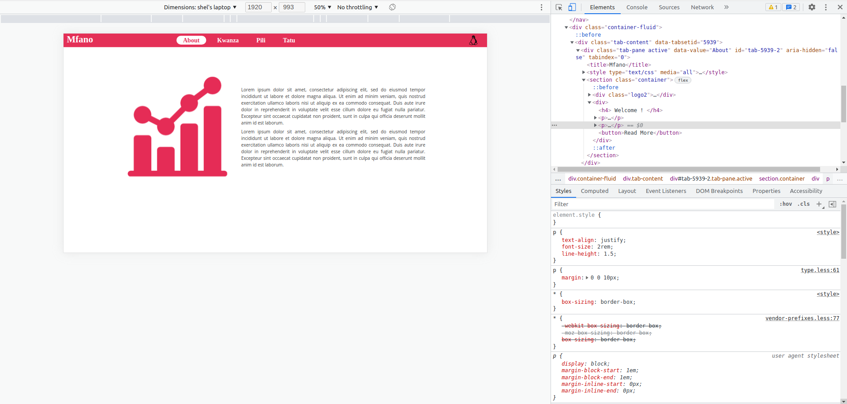
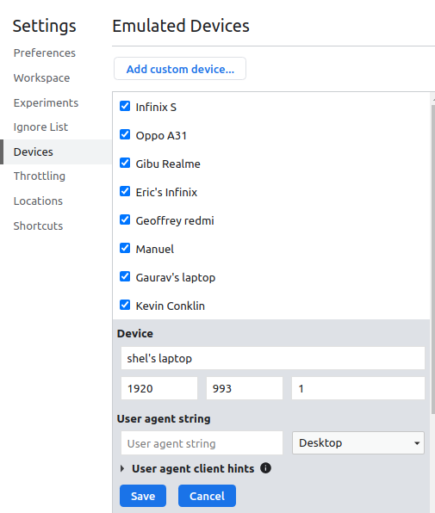
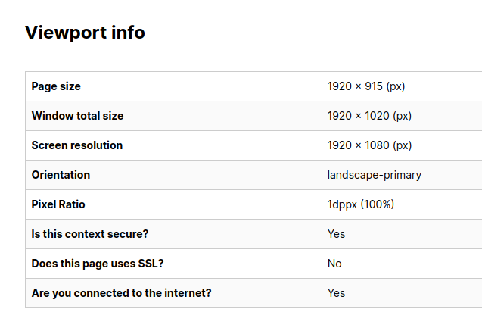
Inspect Browser
bit.ly/mfano
.
Right click, inspect
myviewport.com

Slide 13

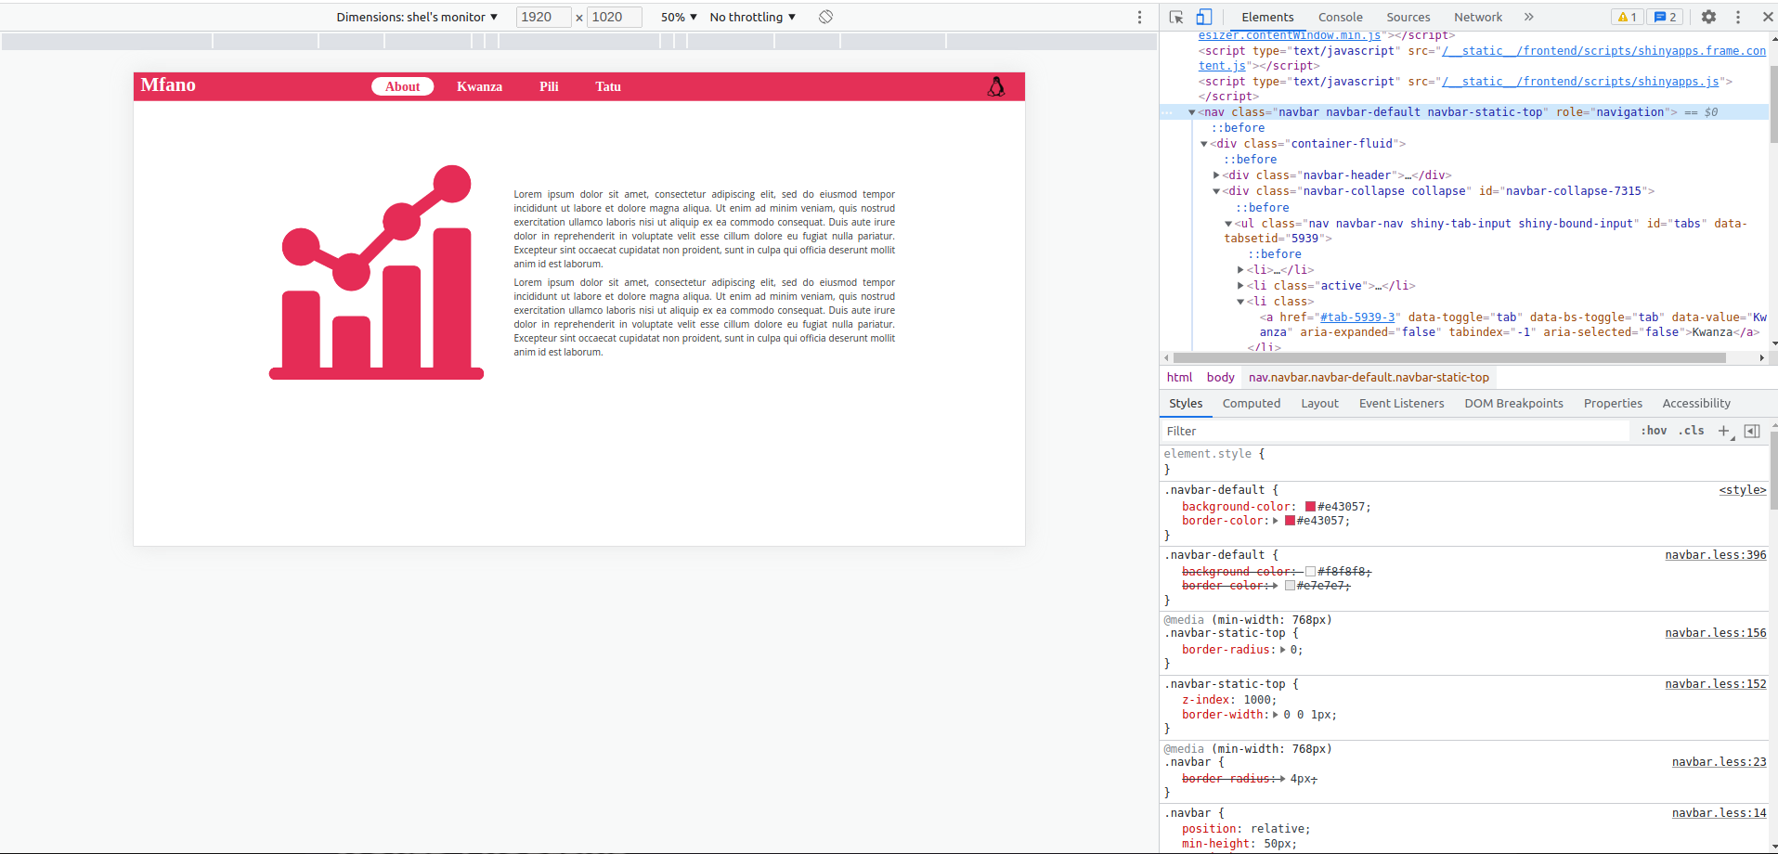
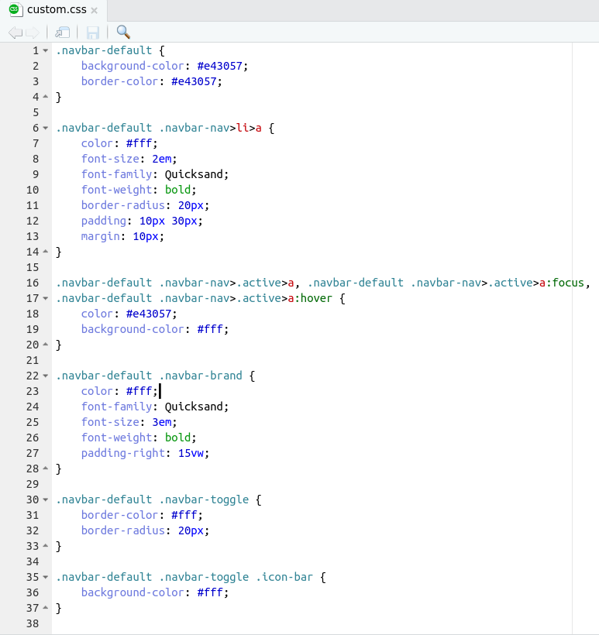
Inspect Browser
.
bit.ly/mfano

Slide 14
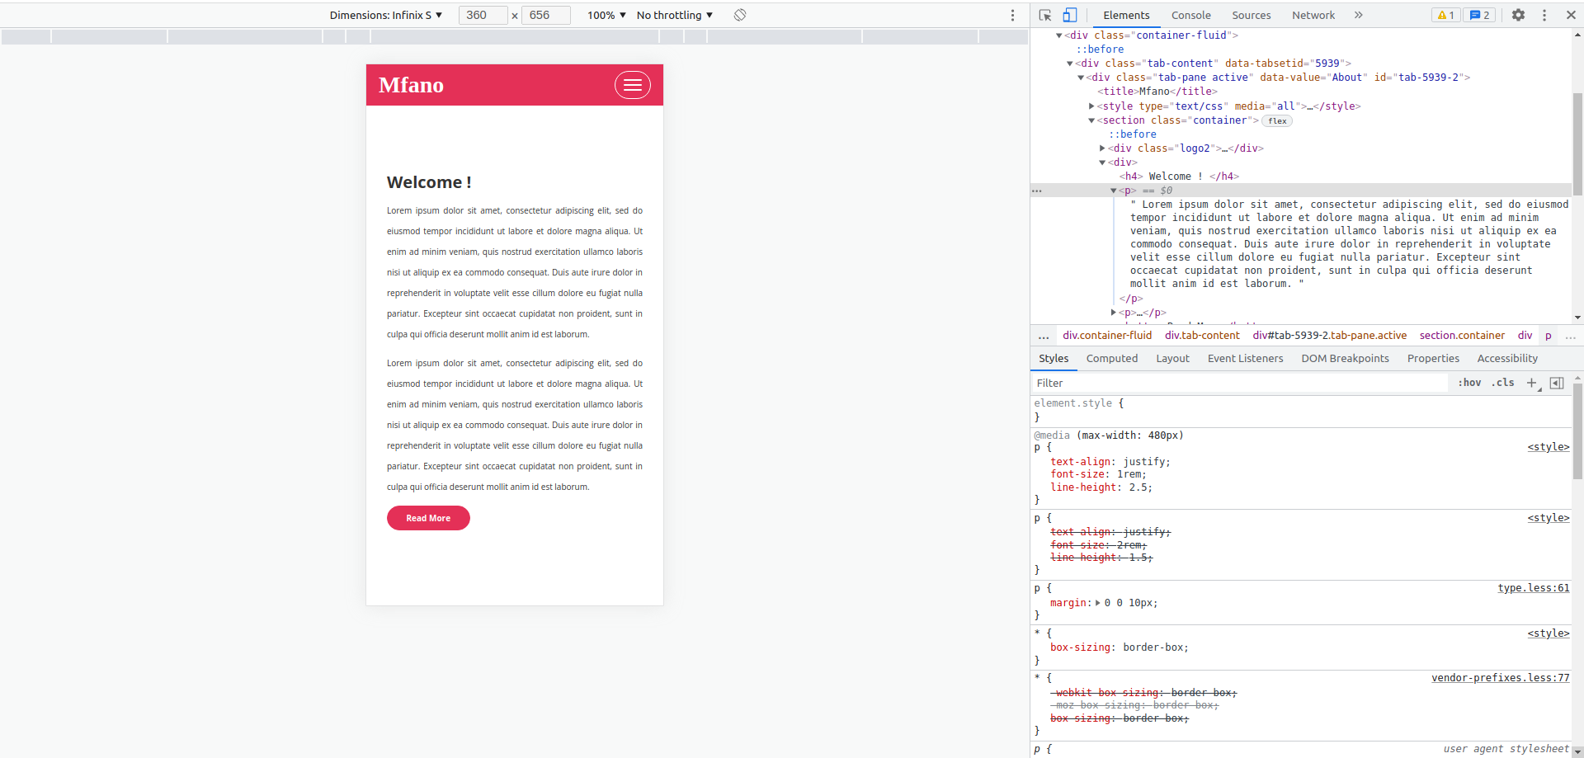
bit.ly/mfano

Slide 15
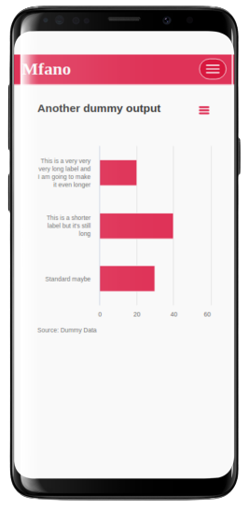
bit.ly/mfano
Result

Slide 16

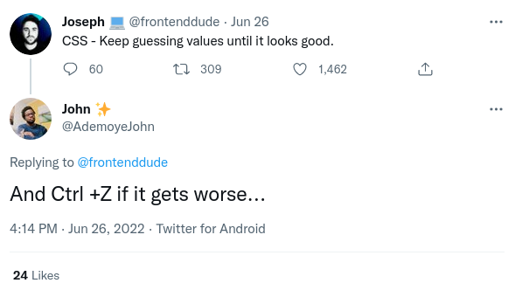
Disclaimer
Check out bootstrap and {bslib}
I am not a css pro YET, so I believe my code could be more efficient
bit.ly/mfanocode

Slide 17
Thanks !

